Slide 1


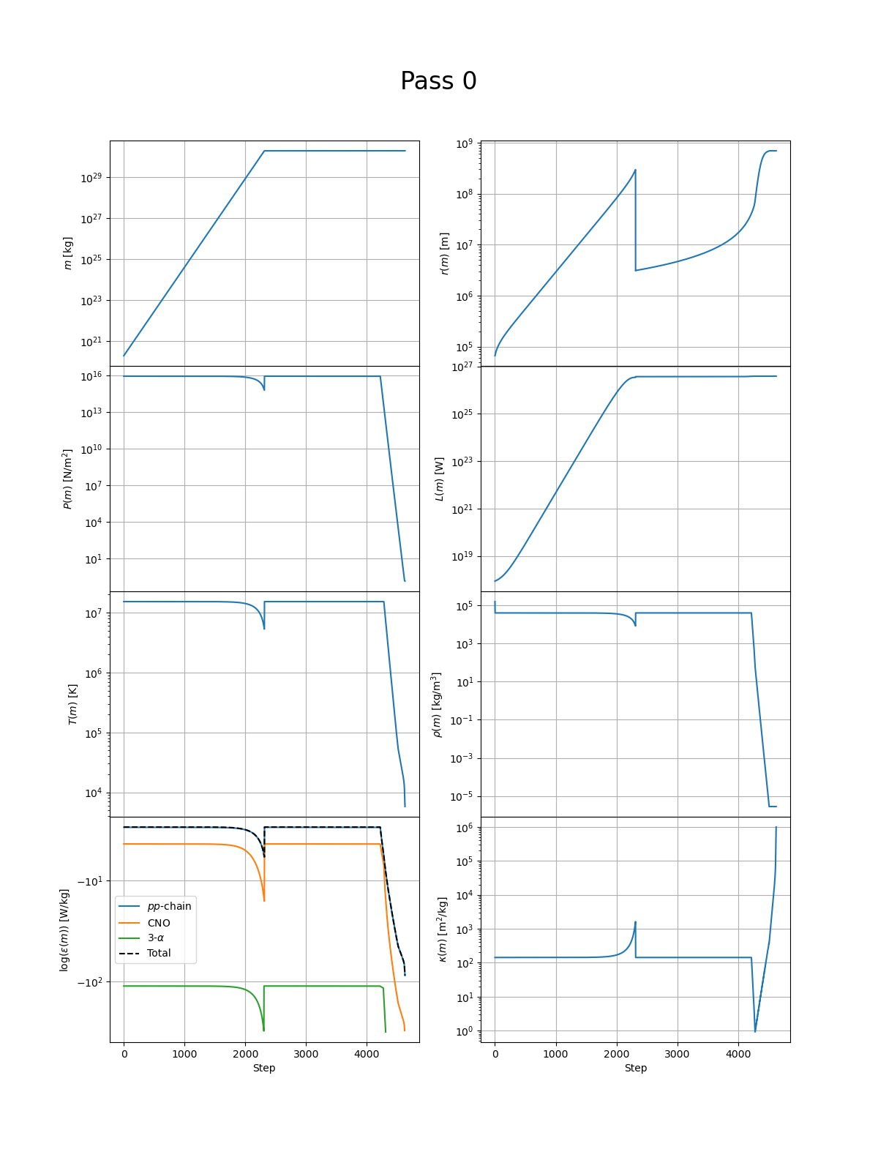
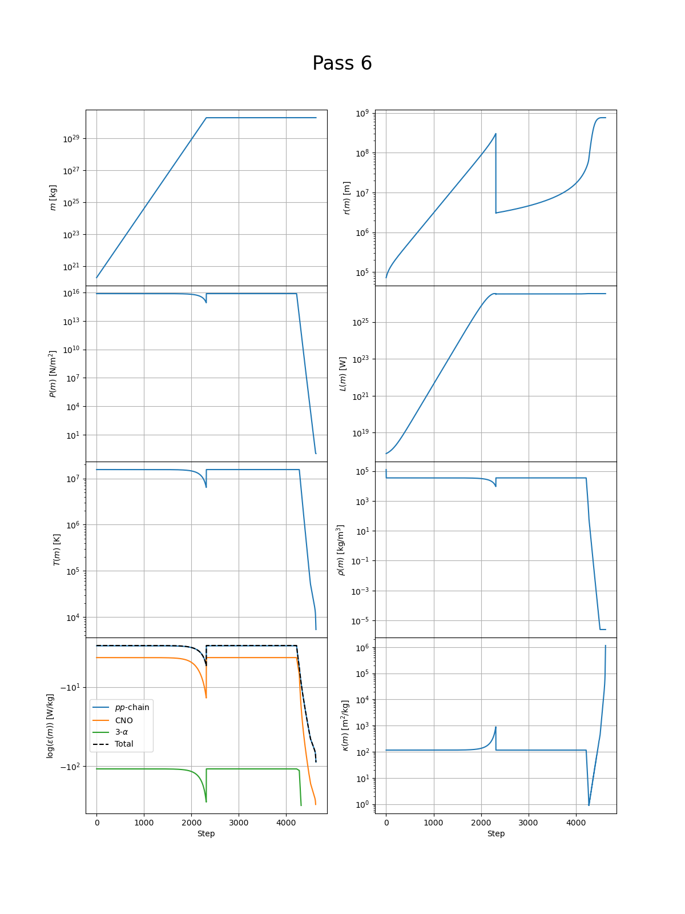
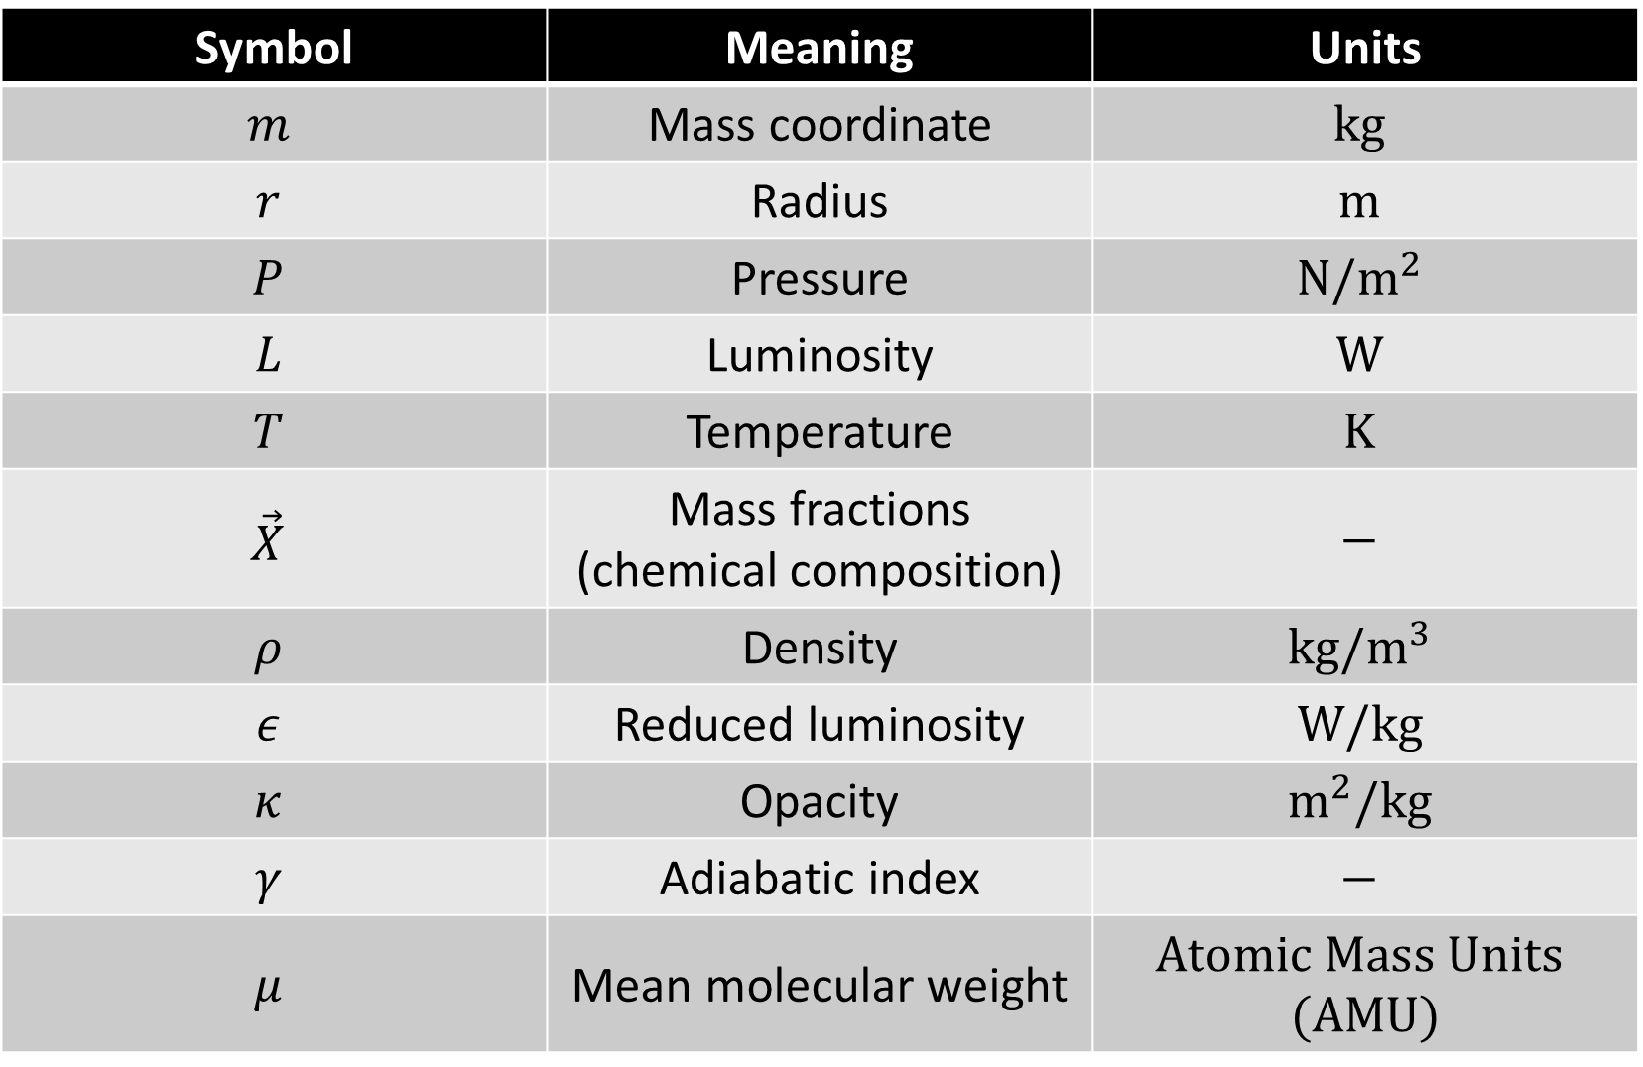
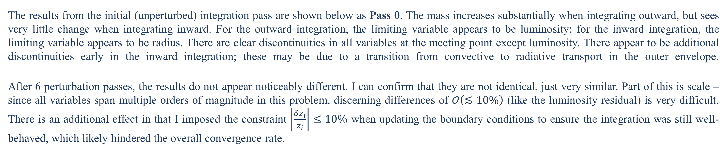
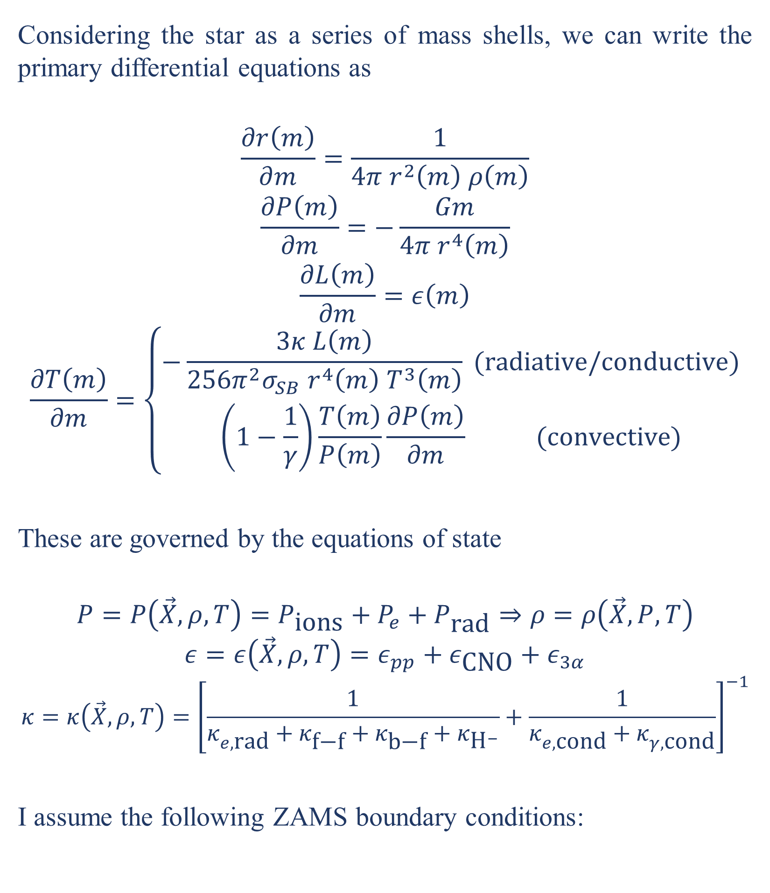
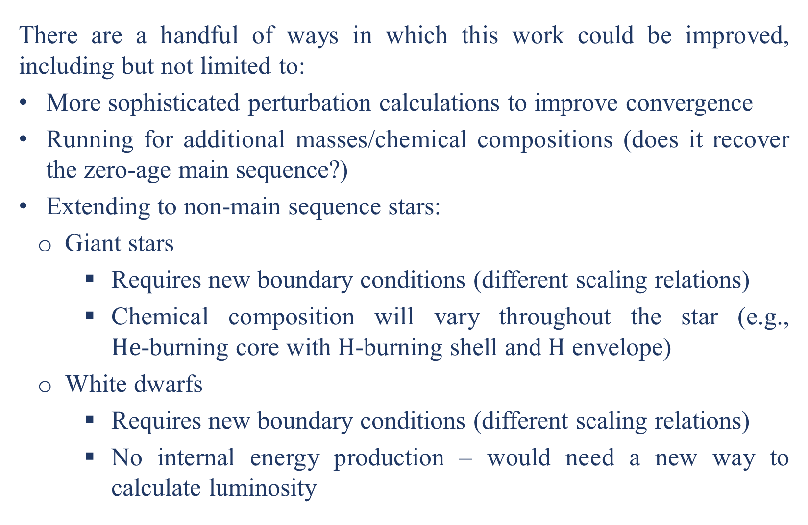

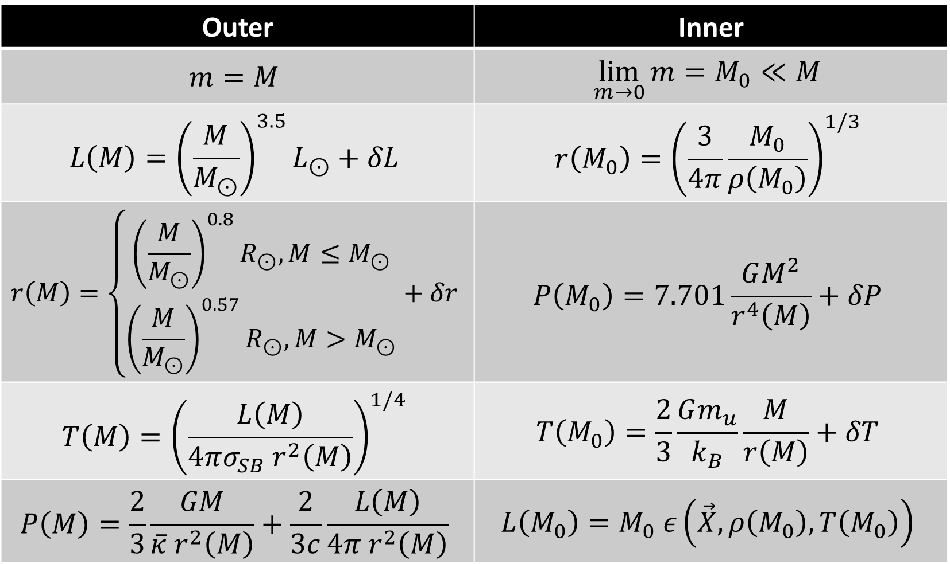
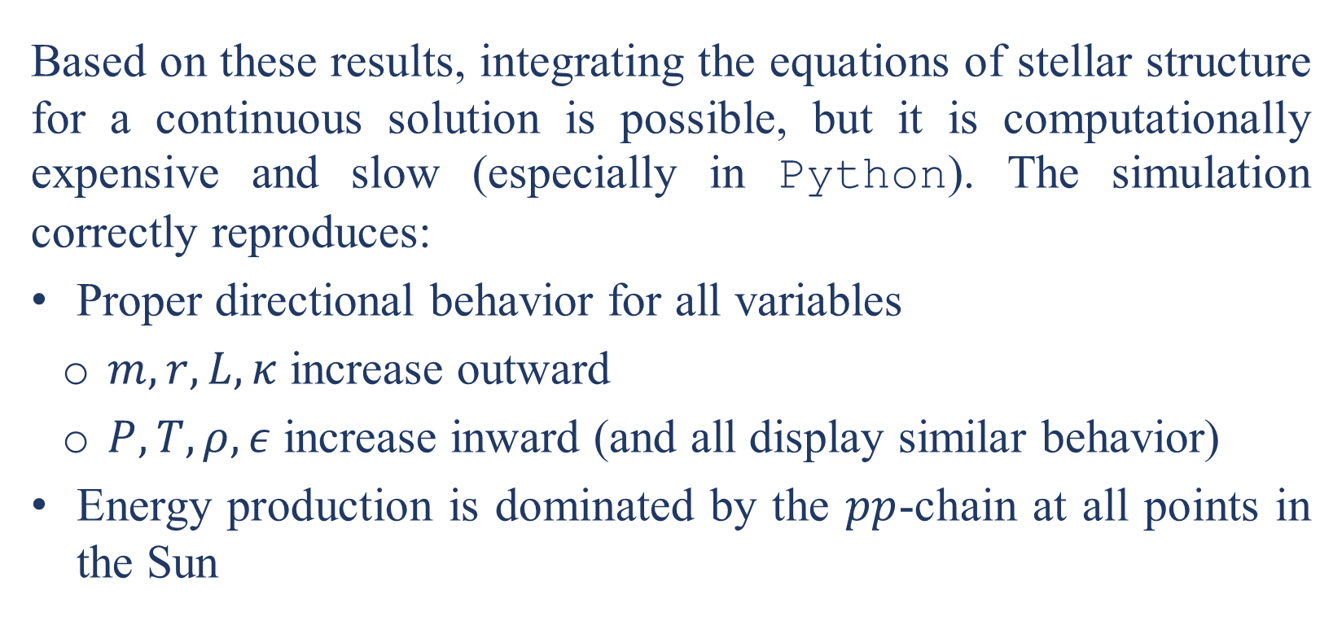
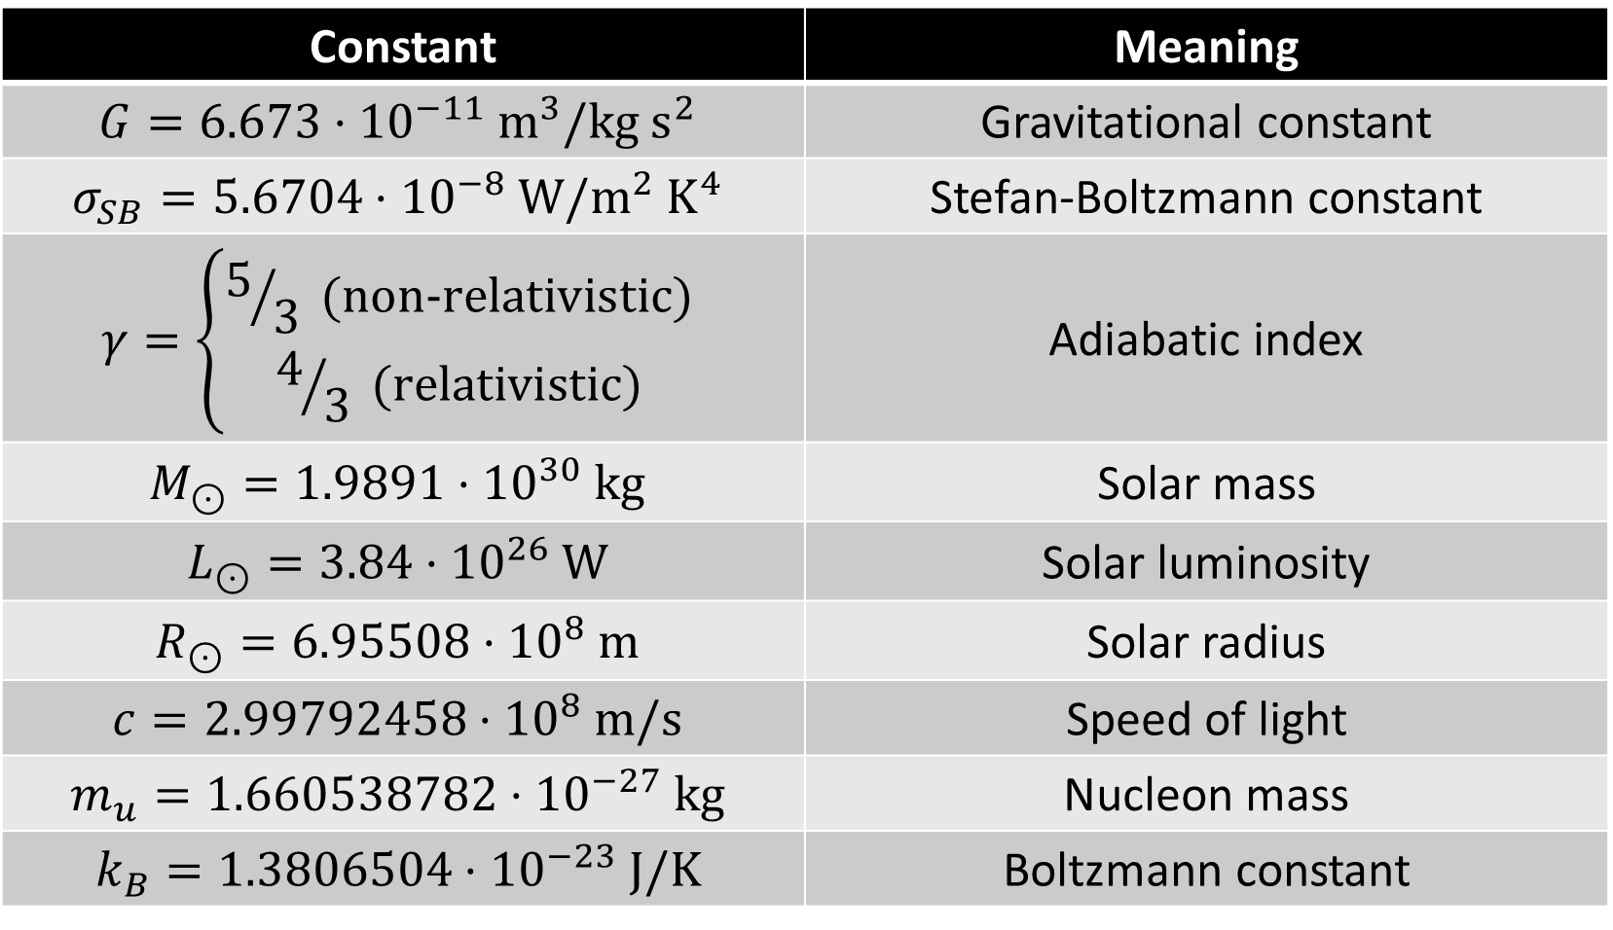
Stellar Structure on the Zero-Age Main Sequence
Brandon Pries
School of Physics, Georgia Institute of Technology
1. Introduction
2. Variables and Constants
5. Results
Stellar structure has been a topic of deep study for decades, in part because of its complexity. Stellar structure is a complicated interplay among a variety of different physical fields: quantum mechanics, statistical mechanics, thermodynamics, hydrodynamics, radiative transport, particle physics, nuclear processes, and electromagnetism, to name a few. For these reasons, modeling stellar structure is difficult, even numerically. In this project, I will attempt to build a model of stellar structure for main sequence stars, specifically considering the test case of the Sun. In particular, I will be attempting to model the zero-age main sequence (ZAMS); this allows for the simplification that the chemical composition is isotropic throughout the star. At later stages in a star’s life, this assumption is no longer valid (for example, the core will become enriched in heavier elements).
The variables used in this project include
with constants
The results from the initial (unperturbed) integration pass are shown below as Pass 0. The mass increases substantially when integrating outward, but sees very little change when integrating inward. For the outward integration, the limiting variable appears to be luminosity; for the inward integration, the limiting variable appears to be radius. There are clear discontinuities in all variables at the meeting point except luminosity. There appear to be additional discontinuities early in the inward integration; these may be due to a transition from convective to radiative transport in the outer envelope.
After 6 perturbation passes, the results do not appear noticeably different. I can confirm that they are not identical, just very similar. Part of this is scale – since all variables span multiple orders of magnitude in this problem, discerning differences of $𝒪\left(≲10\%\right)$ (like the luminosity residual) is very difficult. There is an additional effect in that I imposed the constraint $\left|\frac{δz_{i}}{z_{i}}\right|≤10\%$ when updating the boundary conditions to ensure the integration was still well-behaved, which likely hindered the overall convergence rate.
Symbol | Meaning | Units
$$m$$ | Mass coordinate | $$\text{kg}$$
$$r$$ | Radius | $$\text{m}$$
$$P$$ | Pressure | $$\text{N}\text{/}{\text{m}}^{2}$$
$$L$$ | Luminosity | $$\text{W}$$
$$T$$ | Temperature | $$\text{K}$$
$$\vec{X}$$ | Mass fractions (chemical composition) | $$−$$
$$ρ$$ | Density | $$\text{kg}\text{/}{\text{m}}^{3}$$
$$ε$$ | Reduced luminosity | $$\text{W}\text{/}\text{kg}$$
$$κ$$ | Opacity | $${\text{m}}^{2}\text{/}\text{kg}$$
$$γ$$ | Adiabatic index | $$−$$
$$μ$$ | Mean molecular weight | $$\text{A}\text{tomic} \text{M}\text{ass} \text{U}\text{nits}\text{ (}\text{AMU}\text{)}$$
3. Equations of Stellar Structure and Boundary Conditions
Considering the star as a series of mass shells, we can write the primary differential equations as
$$\frac{∂r\left(m\right)}{∂m}=\frac{1}{4π r^{2}\left(m\right) ρ\left(m\right)}$$
$$\frac{∂P\left(m\right)}{∂m}=−\frac{Gm}{4π r^{4}\left(m\right)}$$
$$\frac{∂L\left(m\right)}{∂m}=ε\left(m\right)$$
$$\frac{∂T\left(m\right)}{∂m}=\left\{\begin{matrix}−\frac{3κ L\left(m\right)}{256π^{2}σ_{SB} r^{4}\left(m\right) T^{3}\left(m\right)} \text{(}\text{radiative}\text{/}\text{conductive}\text{)} \\ \left(1−\frac{1}{γ}\right)\frac{T\left(m\right)}{P\left(m\right)}\frac{∂P\left(m\right)}{∂m}\text{ (}\text{convective}\text{)}\end{matrix}\right.$$
These are governed by the equations of state
$$P=P\left(\vec{X},ρ,T\right)=P_{\text{ions}}+P_{e}+P_{\text{rad}}⇒ρ=ρ\left(\vec{X},P,T\right)$$
$$ε=ε\left(\vec{X},ρ,T\right)=ε_{pp}+ε_{\text{CNO}}+ε_{3α}$$
$$κ=κ\left(\vec{X},ρ,T\right)={\left[\frac{1}{κ_{e,\text{rad}}+κ_{\text{f}\text{−}\text{f}}+κ_{\text{b}\text{−}\text{f}}+κ_{{\text{H}}^{−}}}+\frac{1}{κ_{e,\text{cond}}+κ_{γ,\text{cond}}}\right]}^{−1}$$
I assume the following ZAMS boundary conditions:
Constant | Meaning
$$G=6.673⋅{10}^{−11} {\text{m}}^{3}\text{/}\text{kg} {\text{s}}^{2}$$ | Gravitational constant
$$σ_{SB}=5.6704⋅{10}^{−8} \text{W}\text{/}{\text{m}}^{2} {\text{K}}^{4}$$ | Stefan-Boltzmann constant
$$γ=\left\{\begin{matrix}5/3\text{ (}\text{non}\text{-}\text{relativistic}\text{)} \\ 4/3\text{ (}\text{relativistic}\text{)}\end{matrix}\right.$$ | Adiabatic index
$$M_{⊙}=1.9891⋅{10}^{30} \text{kg}$$ | Solar mass
$$L_{⊙}=3.84⋅{10}^{26} \text{W}$$ | Solar luminosity
$$R_{⊙}=6.95508⋅{10}^{8} \text{m}$$ | Solar radius
$$c=2.99792458⋅{10}^{8} \text{m}\text{/}\text{s}$$ | Speed of light
$$m_{u}=1.660538782⋅{10}^{−27} \text{kg}$$ | Nucleon mass
$$k_{B}=1.3806504⋅{10}^{−23} \text{J}\text{/}\text{K}$$ | Boltzmann constant
4. Computational Methods
This is a boundary value problem that we can solve with relaxation. However, we only know 4 of the 8 boundary conditions – we need to guess the other 4. Therefore, we can integrate in both directions until our solutions meet in the middle. If they don’t match, we can perturb our guessed boundary conditions to determine how we should update them for a better-matching solution. Therefore, the computational algorithm is:
Specify total mass $M$ and chemical composition $\vec{X}=\left[X_{\text{H}},X_{\text{He}},X_{\text{Li}},…\right]$
Specify internal ($m=M_{0}≪M$) and surface ($m=M$) boundary conditions
Initialize variable arrays ${\vec{z}}_{1}$ (outward) and ${\vec{z}}_{2}$ (inward)
Calculate intermediate variables (e.g., $ρ,κ,ε$) using EOS
Calculate derivatives $\frac{∂{\vec{z}}_{i}}{∂m}$
Set stepsizes $h_{i} \sim \text{min}\left(\frac{∂\ln\left({\vec{z}}_{i}\right)}{∂m}\right)$ with $h_{2}<0$
Update solutions using 4th-order Runge-Kutta integration
Integration step until $m_{1}=m_{2}=m_{mid}$
Calculate residuals $\vec{ℛ}={\vec{z}}_{2}\left(m_{mid}\right)−{\vec{z}}_{1}\left(m_{mid}\right)$
Perturb each guessed boundary condition and calculate new residuals (integration pass for each)
Calculate updates to boundary conditions ($δ\vec{z}$) by solving matrix equation $\sum_{j}{\frac{∂R_{i}}{∂z_{j}} δz_{j}}=−ℛ_{i}$
Perturbations pass until residuals are below some desired error tolerance
Perturbations Pass
Integration Pass
Outer | Inner
$$m=M$$ | $$\lim_{m→0}{m}=M_{0}≪M$$
$$L\left(M\right)={\left(\frac{M}{M_{⊙}}\right)}^{3.5}L_{⊙}+δL$$ | $$r\left(M_{0}\right)={\left(\frac{3}{4π}\frac{M_{0}}{ρ\left(M_{0}\right)}\right)}^{1/3}$$
$$r\left(M\right)=\left\{\begin{matrix}{\left(\frac{M}{M_{⊙}}\right)}^{0.8}R_{⊙}, M≤M_{⊙} \\ {\left(\frac{M}{M_{⊙}}\right)}^{0.57}R_{⊙}, M>M_{⊙}\end{matrix}\right.+δr$$ | $$P\left(M_{0}\right)=7.701\frac{GM^{2}}{r^{4}\left(M\right)}+δP$$
$$T\left(M\right)={\left(\frac{L\left(M\right)}{4πσ_{SB} r^{2}\left(M\right)}\right)}^{1/4}$$ | $$T\left(M_{0}\right)=\frac{2}{3}\frac{Gm_{u}}{k_{B}}\frac{M}{r\left(M\right)}+δT$$
$$P\left(M\right)=\frac{2}{3}\frac{GM}{\overline{κ} r^{2}\left(M\right)}+\frac{2}{3c}\frac{L\left(M\right)}{4π r^{2}\left(M\right)}$$ | $$L\left(M_{0}\right)=M_{0} ε\left(\vec{X},ρ\left(M_{0}\right),T\left(M_{0}\right)\right)$$
6. Conclusions
7. Future Work
Integration Step
Based on these results, integrating the equations of stellar structure for a continuous solution is possible, but it is computationally expensive and slow (especially in Python). The simulation correctly reproduces:
Proper directional behavior for all variables
$m,r,L,κ$ increase outward
$P,T,ρ,ε$ increase inward (and all display similar behavior)
Energy production is dominated by the $pp$-chain at all points in the Sun
There are a handful of ways in which this work could be improved, including but not limited to:
More sophisticated perturbation calculations to improve convergence
Running for additional masses/chemical compositions (does it recover the zero-age main sequence?)
Extending to non-main sequence stars:
Giant stars
Requires new boundary conditions (different scaling relations)
Chemical composition will vary throughout the star (e.g., $\text{He}$-burning core with $\text{H}$-burning shell and $\text{H}$ envelope)
White dwarfs
Requires new boundary conditions (different scaling relations)
No internal energy production – would need a new way to calculate luminosity

